Slide 1

By: Juho, Jonathan, Noa, Nick, Ruben
Notes:
Intro the team and project: We are …
Quick story about why we chose the challenge: We were looking to go big this year and work on a challenge that was meaningful and had an impact on society
Solving the problem of a changing peoples approach to labor market was BIG ‘The ethos of Life Long Learners resonated with us.’

Slide 2
Informed Citizens Make Good Decisions
Life Long Learning
Guiding Philosophy
Notes:
The problem we identified is how do you put people on a path to life long learning? Our guiding philosophy …

Slide 3


User Story
15 years old
Finishing middle school
Likes drawing and comics
Notes:
How does

Slide 4
[Profile]
Notes:
We ask ted some questions to get to know him a bit better. And If he want even offer an aptitude test he could take.

Slide 5
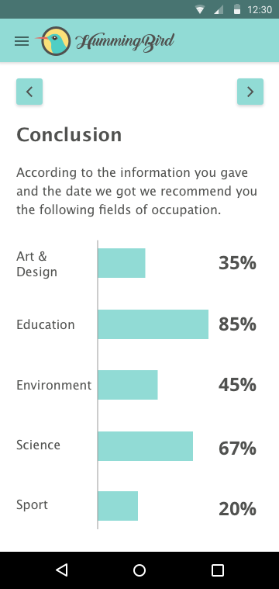
Profiling Magic
Notes:
Through some profiling magic we’ve found ranked some of Ted possible interest. We imagine that some would be obvious but we hope that other might not and to show a wider range of interests

Slide 6
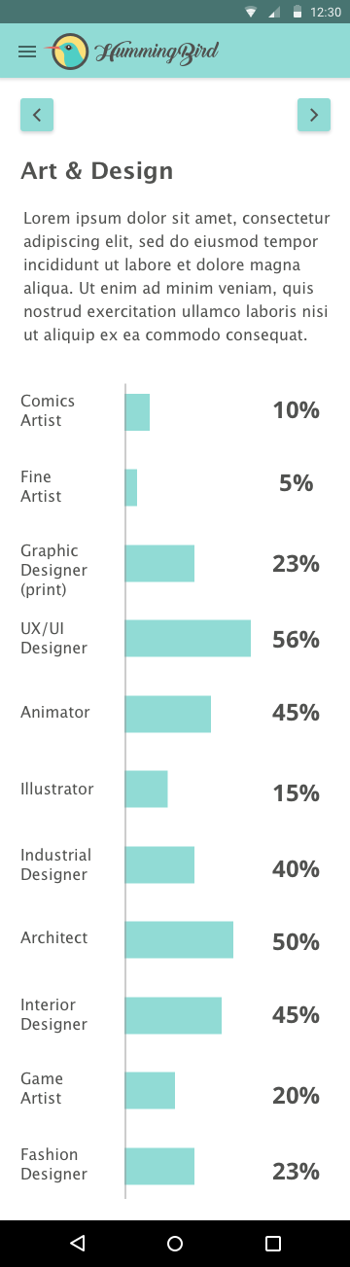


Related Occupations
Notes:
Using European Skills and Competence api ESCOs and data from 1 jobs that are related to their interest field and 2 an employment likelihood value. This Likelihood value is a combination of skill and job prospects

Slide 7
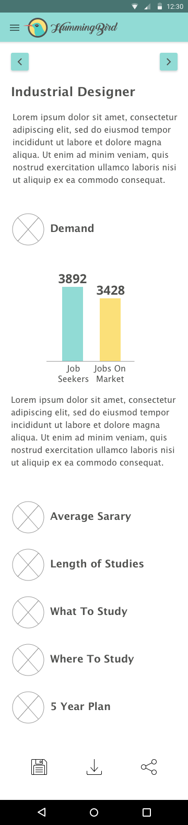


Slide 8
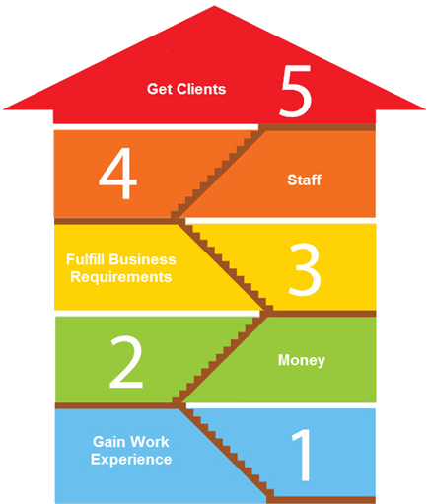
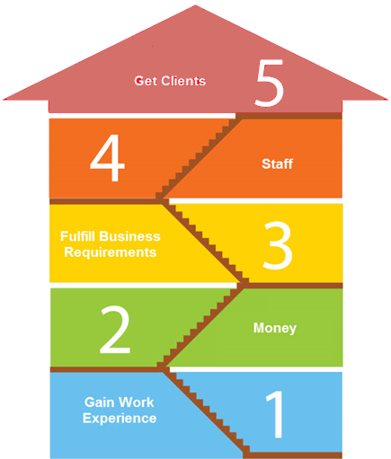
5 year plan of action
5 Year plan of action
Educator Partnerships
Lessen unemployment

Slide 9

Wider Audience

